Slide 1
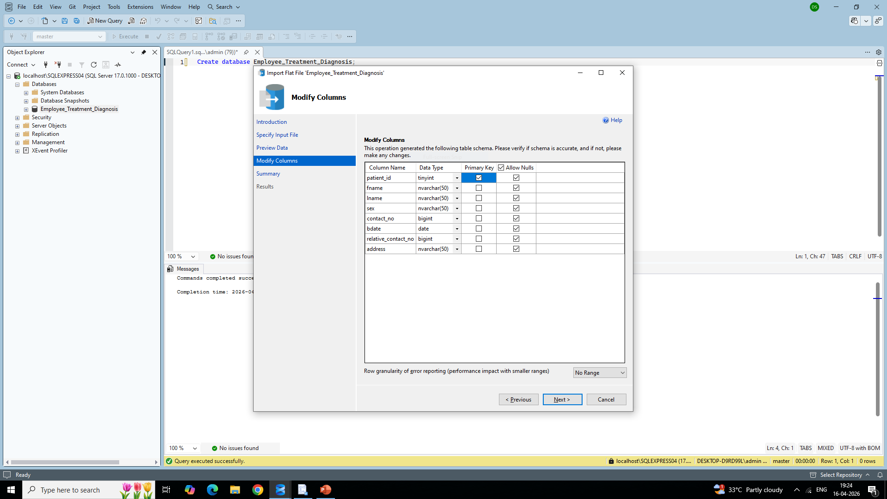
Created a Database with multiple tables by importing CSV files as Data Sources.

Slide 2
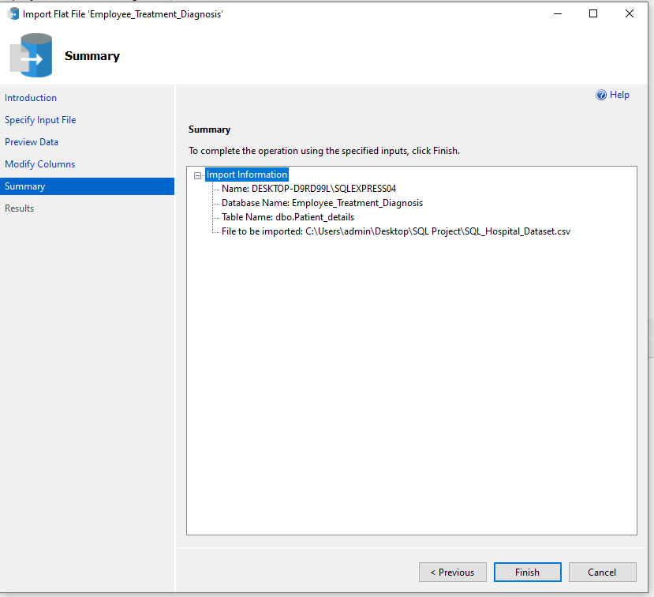
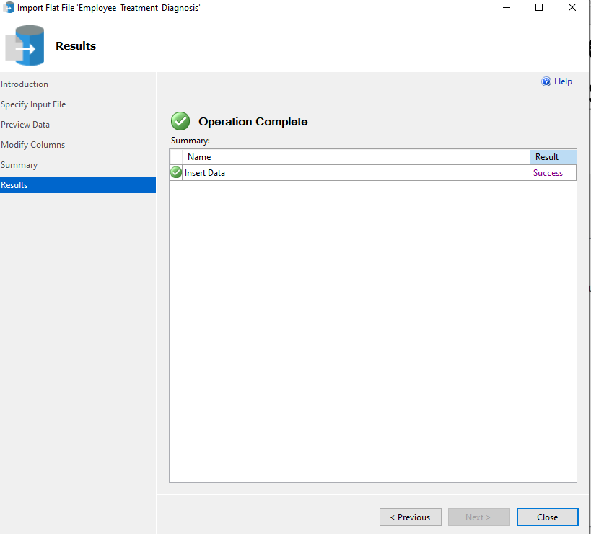
Verify the Table name, Database name, Source and Target names before data import.

Slide 3
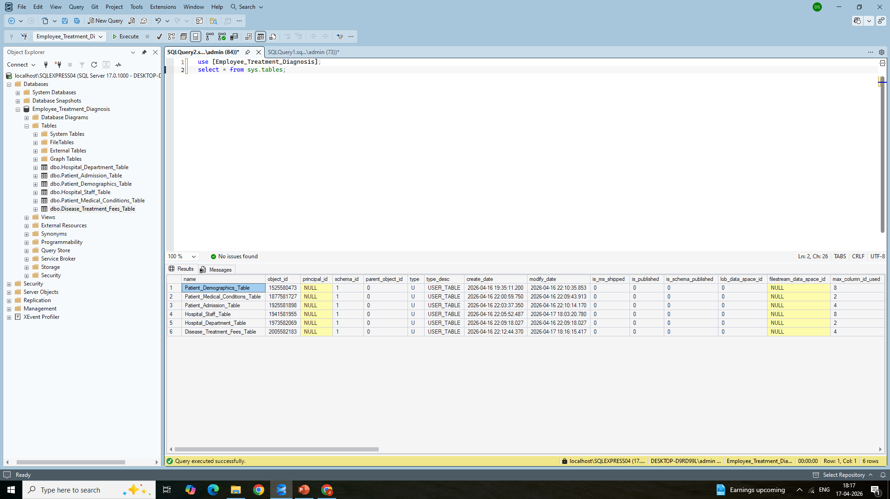
Created 6 tables in the Database

Slide 4
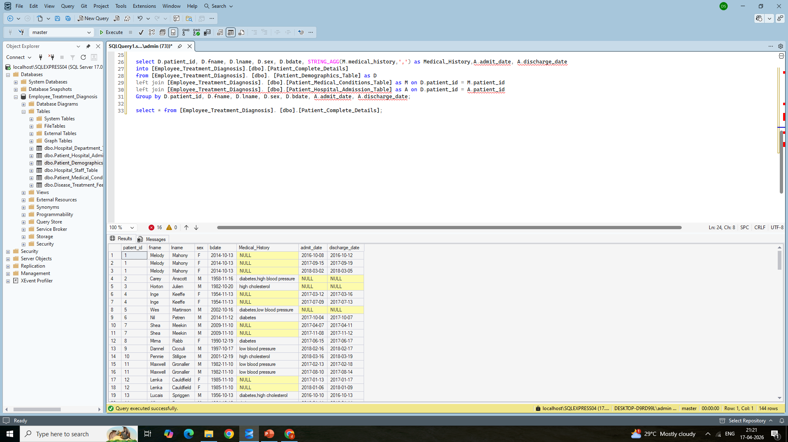
Created a new table to display all medical conditions in a single row along with admission date and discharge date of all patients.

Slide 5
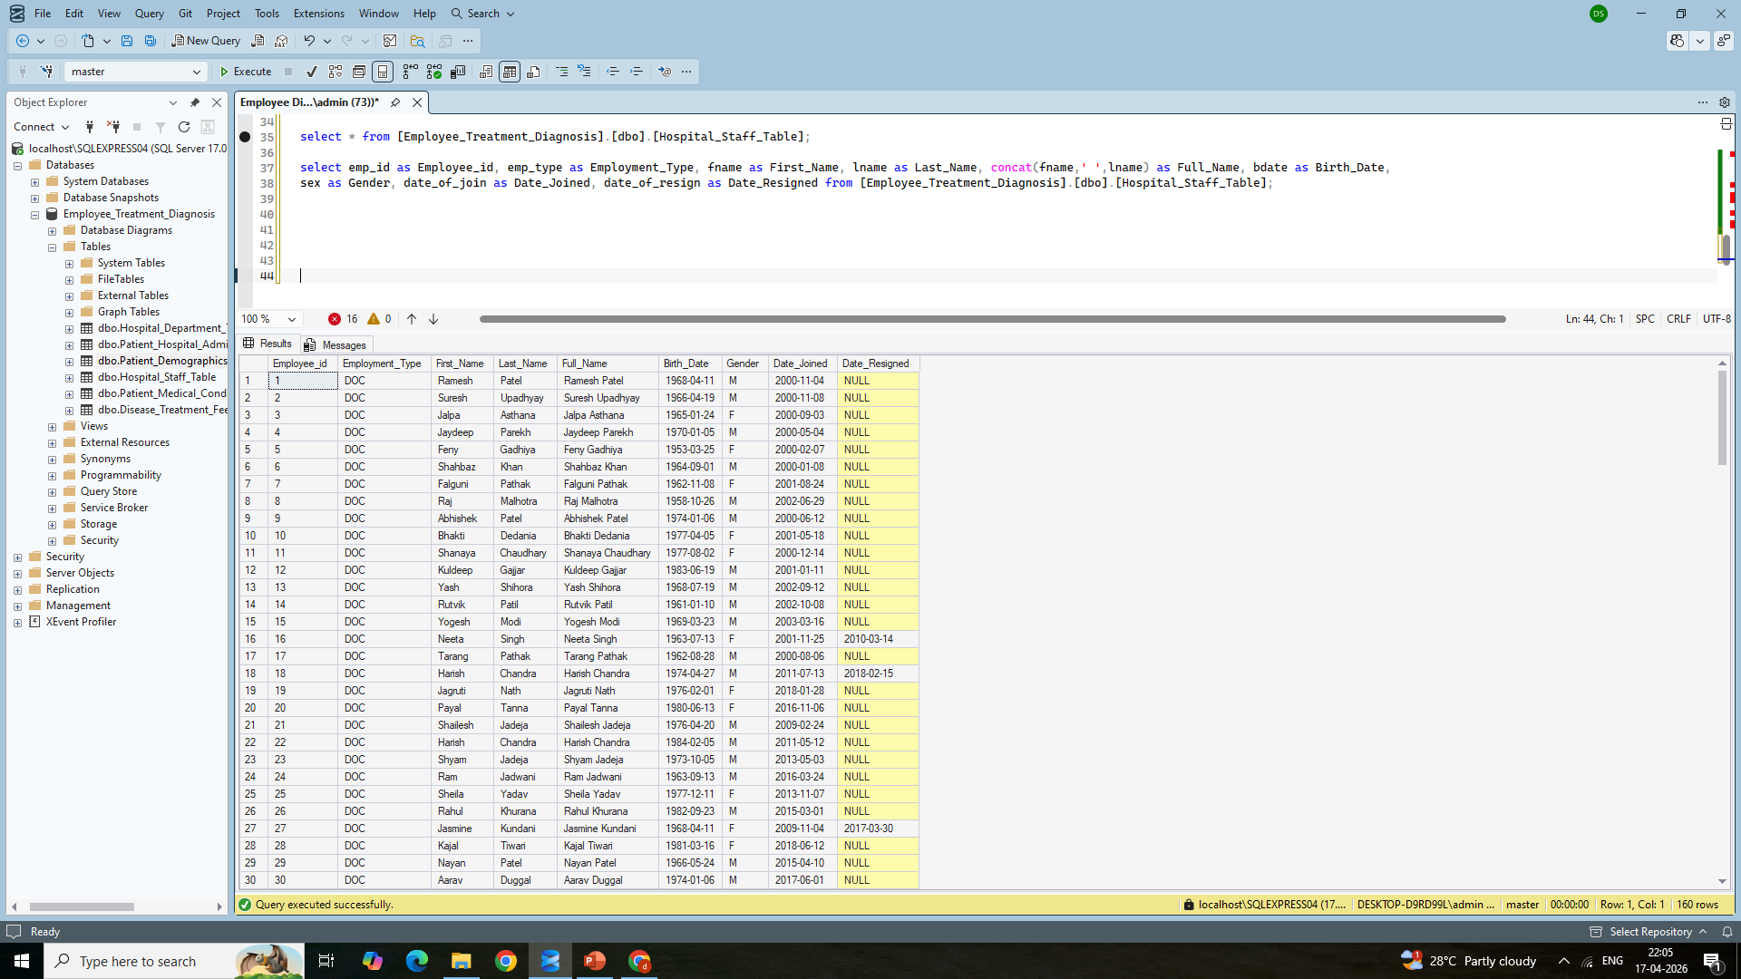
Renamed the column names of Hospital Staff table. Create a new column ‘Full Name’ based on staff first name and last name.

Slide 6
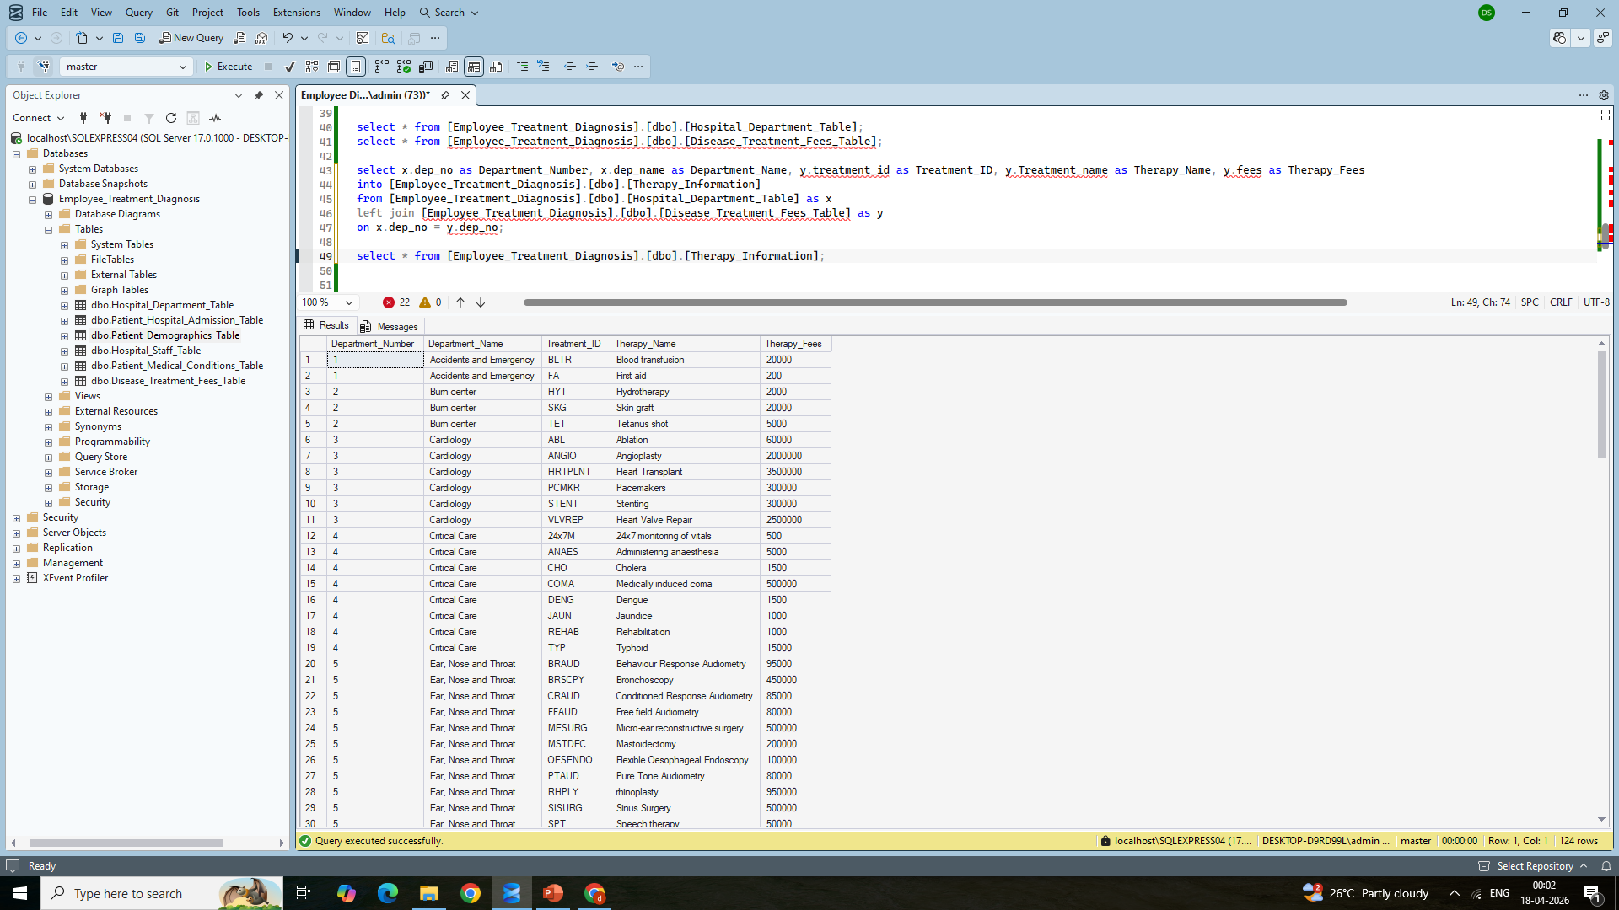
Rename the column names of Hospital Staff table. Create a new column ‘Full Name’ based on staff first name and last name.

Slide 7
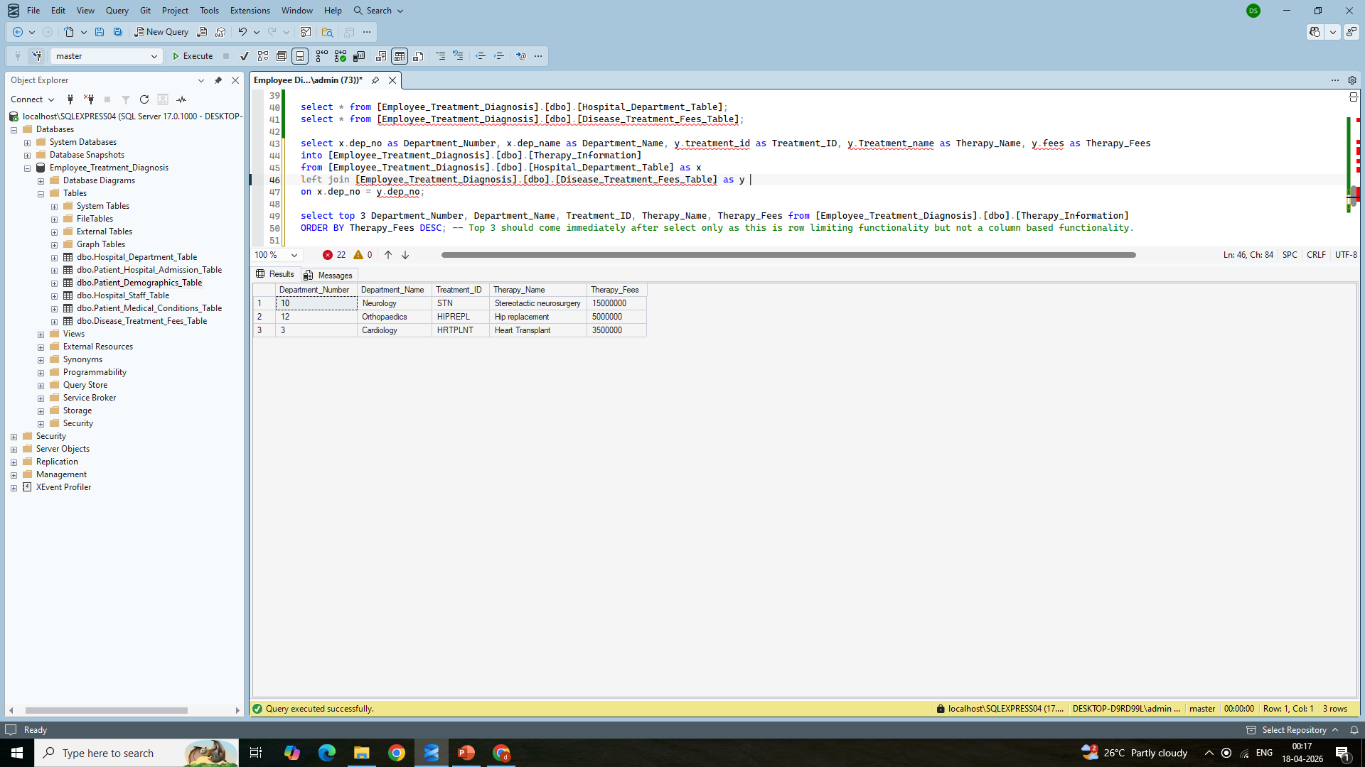
Created a new table from Department and Treatment tables to retrieve top 3 department names with high treatment fees.

Slide 8
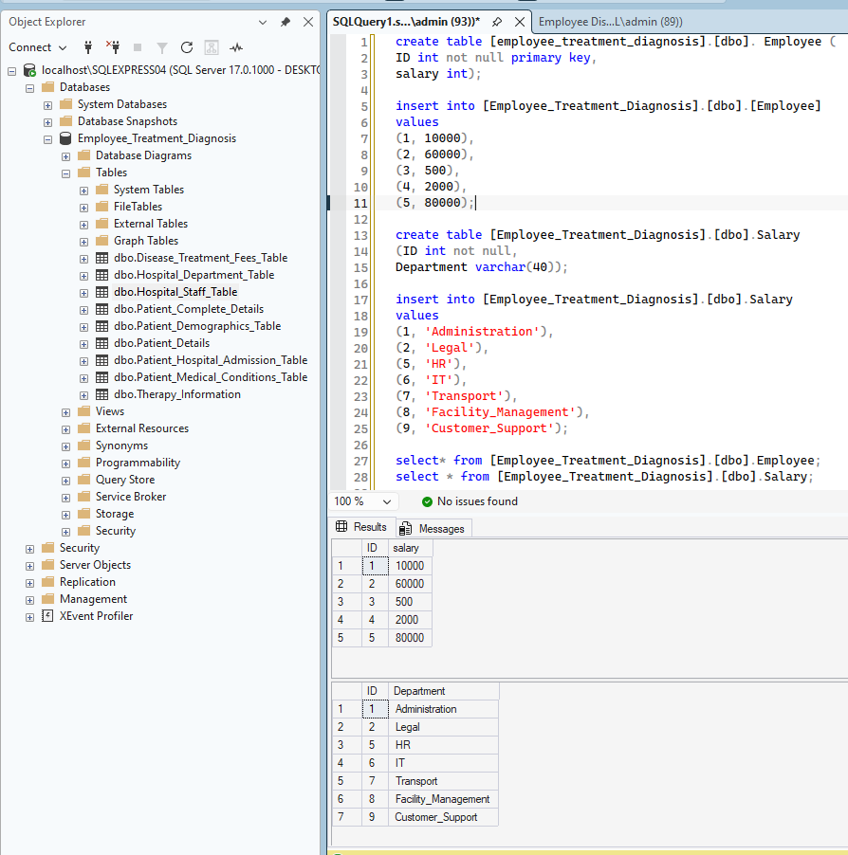
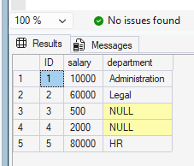
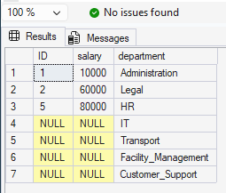
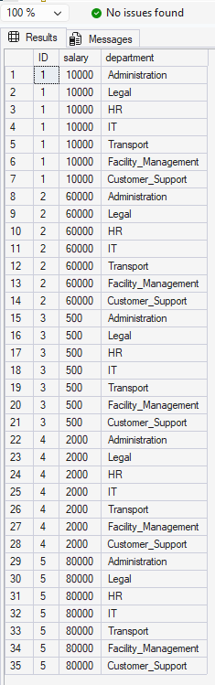
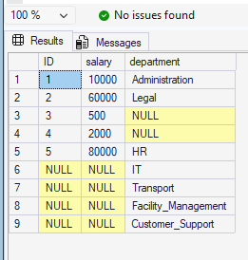
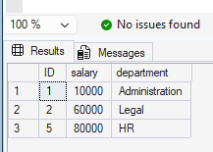
Left Join
Employee Table & Salary Table
Right Join
Cross Join/ Cartesian Product
Full Outer Join
Inner Join

